Slide 1
1. Digital System &Binary Numbers

Slide 2
1.1 Digital System
Digital System
  Communication, Business transaction, Traffic control, other commercial, industrial, scientific enterprises etc.
  Discrete elements of information
Signal
  Discrete elements of information are represented in a digital system by physical quantities
Binary Code
  Discrete elements of information are represented with groups of bits
  bit : binary + digit

Slide 3
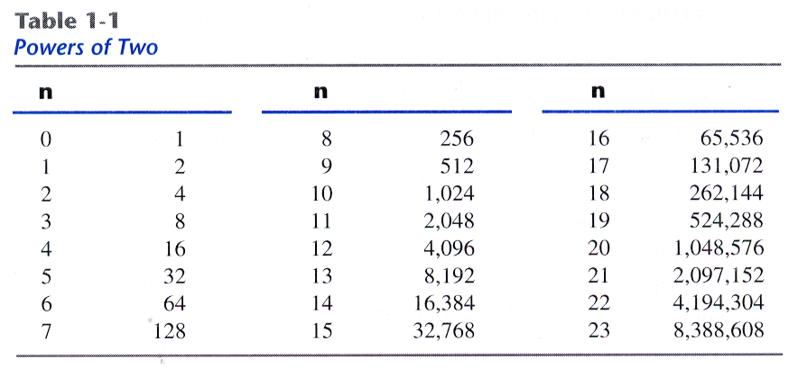

1.2 Binary Number
a₅a₄a₃a₂a₁a₀.a₋₁a₋₂a₋₃
= a_{n}r^{n}+a_{n-1}r^{n-1}+...+a₂r²+a₁r+a₀+a₋₁r⁻¹+a₋₂r⁻²+...+a_{-m}r^{-m}
7392 = 7 × 10³ + 3 × 10² + 9 × 10¹ +2 × 10⁰
(11010.11)₂ =1×2⁴+1×2³+0×2²+1×2¹+0×2₀+1×2₋₁+1×2₋₂
= (26.75)₁₀
2¹⁰
2²⁰
2³⁰
= 1Kilo
= 1Mega
= 1Giga

Slide 4
1.2 Binary Number
Augend | 101101 | Minuend: | 101101 | Multiplicand: | 101
Addend | +100111 | Subtrahend: | -100111 | Multiplier: | *101
sum | 1010100 | Difference: | 000110 |  | 1011
 |  |  |  |  | 0000
 |  |  |  |  | 1011
 |  |  |  | Product: | 10111

Slide 5
1.3 Number Base Conversions
Ex 1-1) Convert decimal 41 to binary.
answer : (41)10 = (a₅a₄a₃a₂a₁a₀)₂ = (101001)₂
Integer | Remainder
41
20 | 1
10 | 0
5 | 0
2 | 1
1 | 0
0 | 1
 | Integer Quotient |  | Remainder | Coefficient
41/2 = | 20 | + | ½ | a₀ = 1
20/2 = | 10 | + | 0 | a₁ = 0
10/2 = | 5 | + | 0 | a₂ = 0
5/2 = | 2 | + | ½ | a₃ = 1
2/2 = | 1 | + | 0 | a₄ = 0
1/2 = | 0 | + | ½ | a₅ = 1
Answer
=101001

Slide 6
1.3 Number Base Conversions
Ex 1-2) Convert decimal 153 to octal.
Ex 1-3) Convert (0.6875)10 to binary.
153
19 | 1
2 | 3
0 | 2 = (231)₈
 | Integer |  | Fraction | Coefficient
0.6875*2 = | 1 | + | 0.3750 | a₋₁ = 1
0.3750*2 = | 0 | + | 0.7500 | a₋₂ = 0
0.7500*2 = | 1 | + | 0.5000 | a₋₃ = 1
0.5000*2 = | 1 | + | 0.0000 | a₋₄ = 1
Answer:(0.6875)10 = (0.a₋₁a₋₂a₋₃a₋₄)₂ = (0.1011)₂

Slide 7
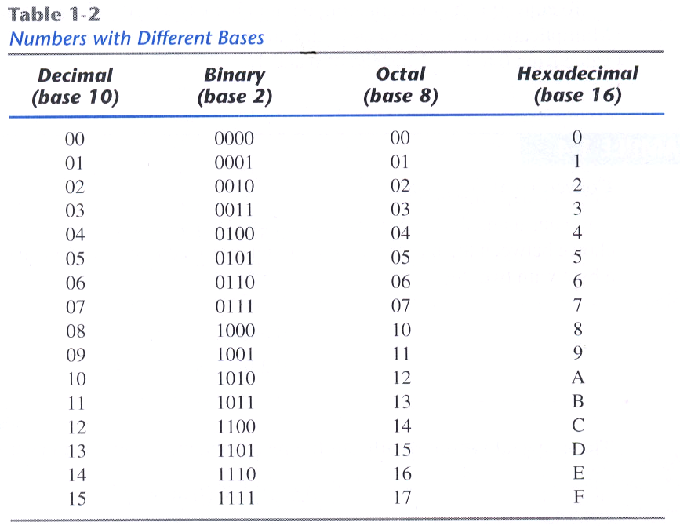
1.4 Octal and Hexadecimal Numbers
( 10 110 001 101 011 . 111 100 000 110 )₂ = (26153.7460)₈
2 6 1 5 3 7 4 0 6
( 10 1100 0110 1011 . 1111 0010 )₂ = (2C6B.F2)₁₆
2 C 6 B F 2

Slide 8
1.5 Complements – Diminished Radix Complement
(r-1)’s complements of N is (r^{n}-1)-N
r=10, r-1=9, 9’complements of N is (10^{n}-1)-N
Ex) the 9’s complements of 546700 is 999999-546700 = 453299
the 9’s complements of 012398 is 999999-012398 = 987601
For binary number, r=2, r-1=1
1’complements of N is (2^{n}-1)-N
Ex) the 1’s complements of 1011000 is 0100111
the 1’s complements of 0101101 is 1010010

Slide 9
1.5 Complements – Radix Complement
The r’s complements of an n-digit number N is r^{n}-N, N≠0
0, N=0
r^{n}-N=[(r^{n}-1)-N]+1
→ The r’s complements is obtained by adding 1 to the (r-1)’s complements
Ex) The 10’s complements of 012398 is 987602
The 10’s complements of 246700 is 753300
The 2’s complements of 1101100 is 0010100
The 2’s complements of 0110111 is 1001001

Slide 10
1.5 Complements – Subtraction with Complements
Ex1-5) using 10’s complement, subtract 72532-3250.
Ex1-6) Using 10’s complement, subtract 3250-72532.
There is no end carry
Therefore, the answer is –(10’s complement of 30718)=-69282
M = | 72532
10’s complement of N = | + 96750
Sum = | 169282
Discard end carry 10⁵ = | -100000
Answer = | 69282
M = | 03250
10’s complement of N = | +27468
Sum = | 30718

Slide 11
1.5 Complements – Subtraction with Complements
Ex1-7) X=1010100, Y=1000011, (a) X-Y, (b) Y-X
(a) X-Y
X = | 1010100
2’s complement of Y = | +0111101
Sum = | 10010001
Discard end carry 2⁷ = | -10000000
Answer: X-Y = | 0010001
(b) Y-X
Y = | 1000011
2’s complement of X = | +0101100
Sum = | 1101111
There is no carry.
The answer is Y-X = -(2’s complement of 1101111)=-0010001

Slide 12
1.5 Complements – Subtraction with Complements
Ex1-8) Repeat Example 1-7 using 1’complement.
(a) X-Y = 1010100-10000011
X = | 1010100
1’s complement of Y = | +0111100
Sum = | 10010000
End-around carry = | + 1
Answer: X-Y = | 0010001
(b) Y-X = 10000011-1010100
Y = | 1000011
1’s complement of X = | +0101011
Sum = | 1101110
There is no carry.
The answer is Y-X = -(1’s complement of 1101110)=-0010001

Slide 13
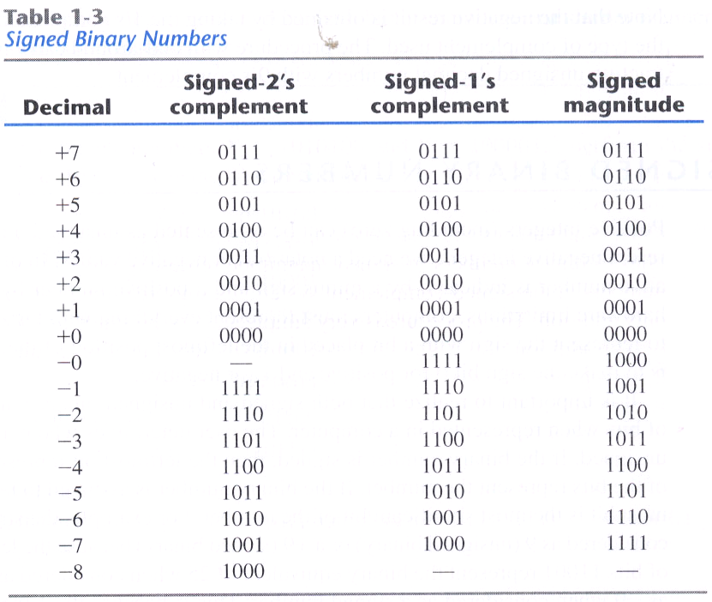
1.6 Signed Binary Numbers
Ex) The number 9 represented in binary with eight bit
+9 : 00001001
-9 : 10001001 (signed-magnitude representation)
11110110 (signed-1’s-complement representation)
11110111 (signed-2’s-complement representation)

Slide 14
1.6 Signed Binary Numbers
Arithmetic Addition
- signed-magnitude system follows the rules of ordinary arithmetic.
- signed-complement system requires only addition.
Arithmetic Subtraction
(±A)-(+B) = (±A)+(-B)
(±A)-(-B) = (±A)+(+B)
+6 |  | 00000110 |  | -6 |  | 11111010
+13 |  | 00001101 |  | +13 |  | 00001101
+19 |  | 00010011 |  | +7 |  | 00000111
+6 |  | 00000110 |  | -6 |  | 11111010
-13 |  | 11110011 |  | -13 |  | 11110011
-7 |  | 11111001 |  | -19 |  | 11101101

Slide 15
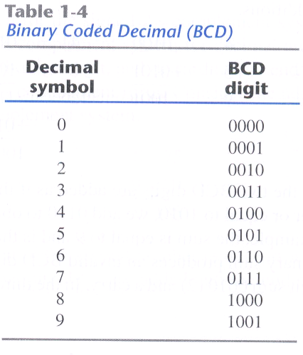
1.7 Binary Code-BCD code
- the 4-bit code for one decimal
(185)₁₀ = (0001 1000 0101)_{BCD} = (10111001)₂
BCD Addition
- if the binary sum is greater or equal to 1010, we add 0110 to obtain the correct BCD
4 |  | 0100 |  | 4 |  | 0100 |  | 8 |  | 1000
+5 |  | +0101 |  | +8 |  | +1000 |  | +9 |  | +1001
9 |  | 1001 |  | 12 |  | 1100 |  | 17 |  | 10001
 |  |  |  |  |  | +0110 |  |  |  | +0110
 |  |  |  |  |  | 10010 |  |  |  | 10111

Slide 16
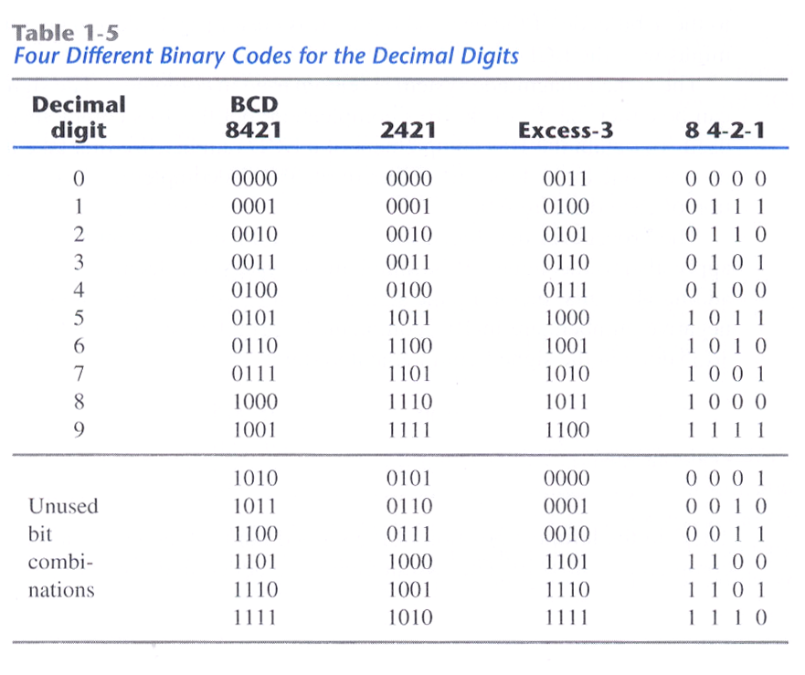
1.7 Binary Code-Other Decimal Codes

Slide 17
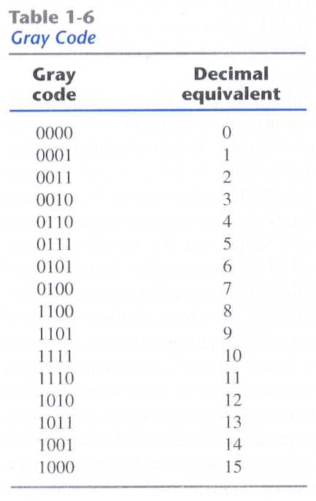
1.7 Binary Code-Gray Code

Slide 18
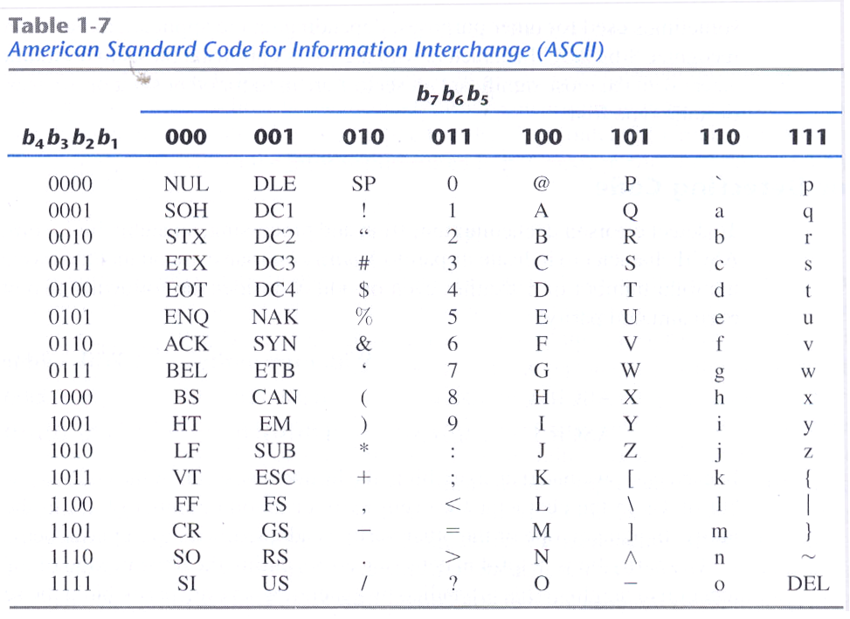
1.7 Binary Code- ASCII Character Code

Slide 19
1.7 Binary Code – Error-Detecting Code
Error-Detecting Code
 | With even parity | With odd parity
ASCII A = 1000001 | 01000001 | 11000001
ASCII T = 1010100 | 11010100 | 01010100

Slide 20
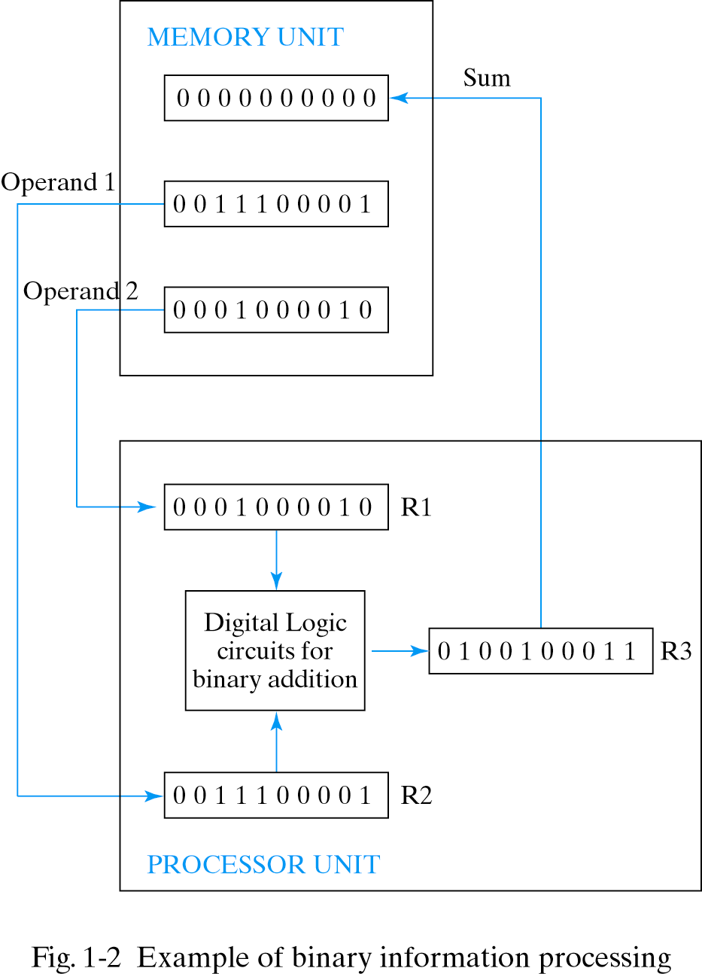
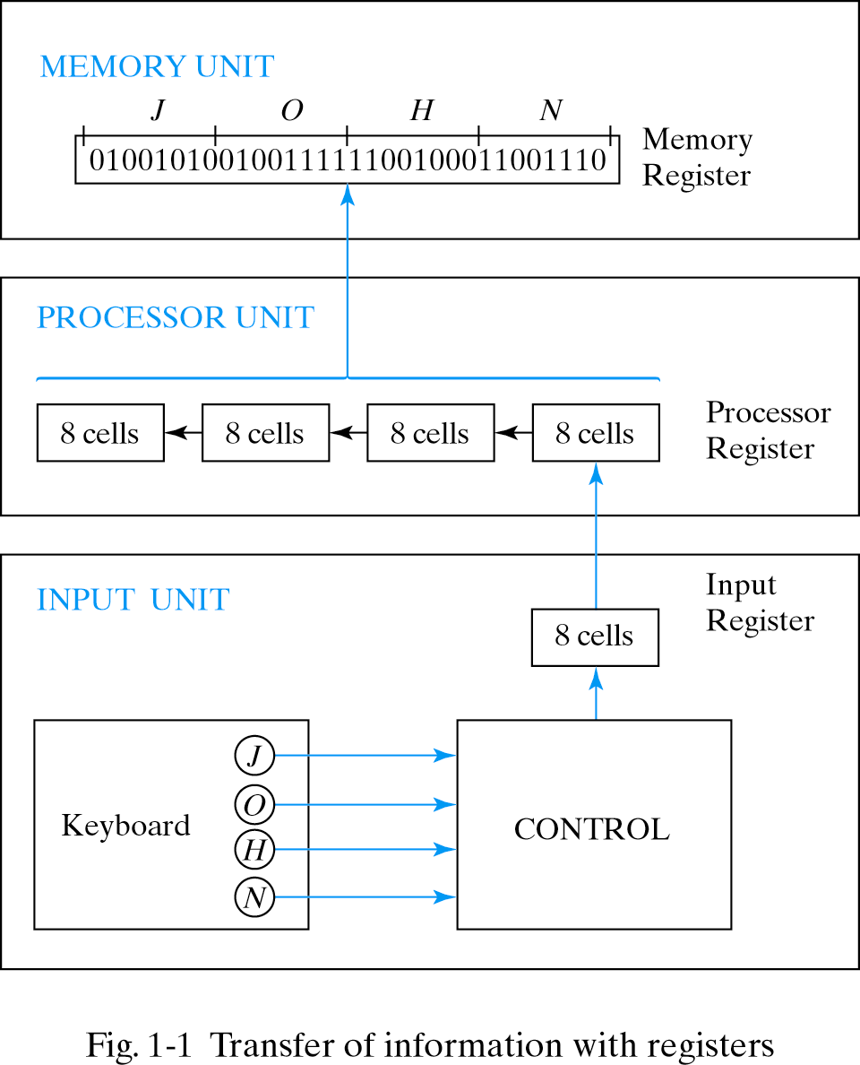
1.8 Binary Storage and Registers
Registers – A register with n cells can store any discrete
quantity of information that contains n bits.
Register Transfer

Slide 21
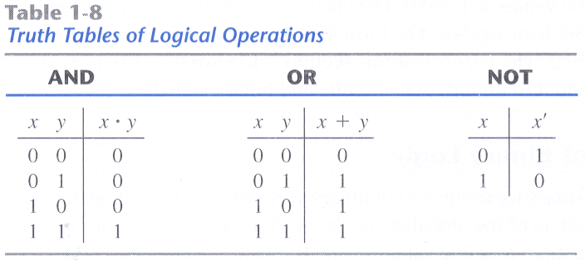
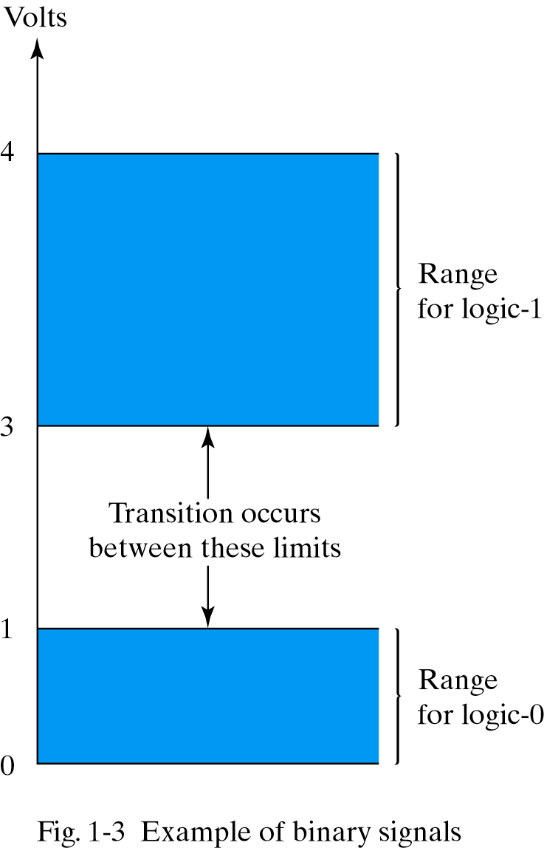


1.9 Binary Logic
Definition of Binary Logic
Logic Gates

Slide 22
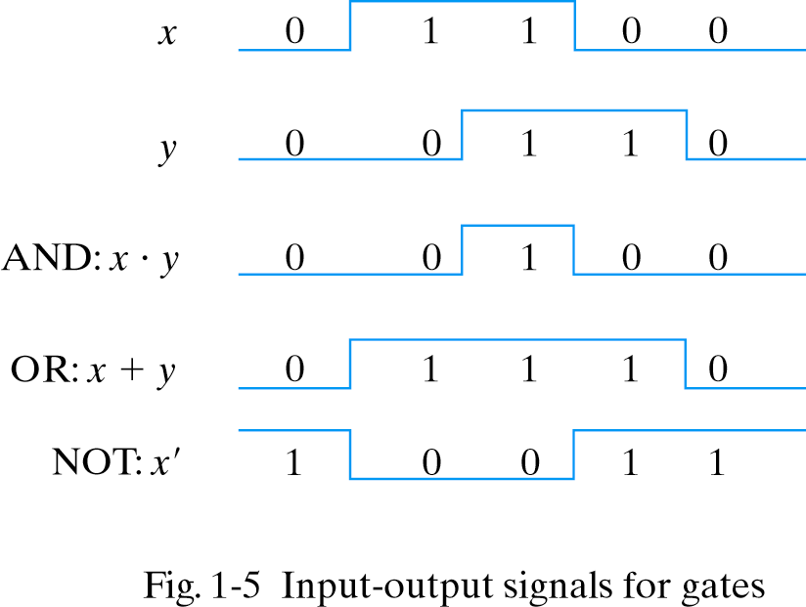
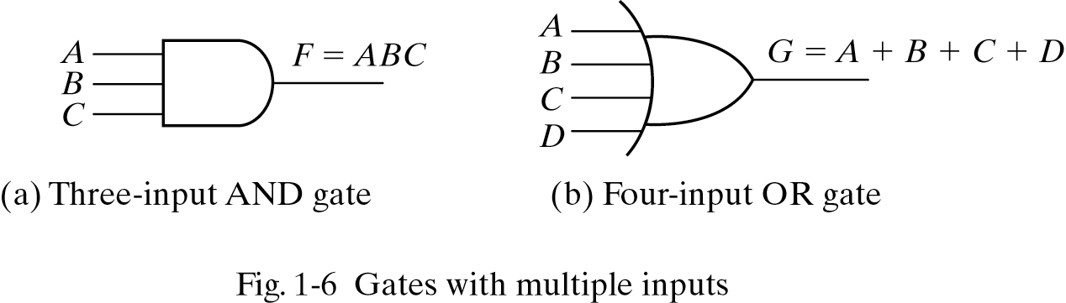
1.9 Binary Logic

